Slide 1

Major Project Final Viva –Voice Bachelor of Computer Application VI Semester – 2024
School of Computer Science and Applications

Slide 2
A PROJECT REPORT ON Real-time Translation of Indian Sign Language to Text and Speech
Submitted Final Viva-Voce Project report completion of BCA degree
Presented by:
Abhishek Chowdhury
R21DA002
Aman Kumar
R21DA008
Amisha
R21DA009
Internal Guide : Dr S Senthil, Professor and Director

Slide 3
Agenda
Existing System
Proposed System
Advantages of Proposed System
Methodology Used
Architecture Diagram
Testing Strategy
Implementation
Result
Future Enhancement

Slide 4
Introduction
Our project aims to develop a real-time translation system for Indian Sign Language (ISL) to text and speech, bridging communication gaps for the deaf and hard of hearing.
Motivated to empower ISL users, we seek to improve accessibility and inclusivity in diverse settings, such as education, employment, and social interactions.
Objectives include creating a prototype system for accurate ISL translation and benefiting ISL users, caregivers, educators, and communication technology stakeholders.
By developing this system, we aim to facilitate seamless communication and foster understanding between ISL users and the wider community.
Our ultimate goal is to promote inclusivity and accessibility, enabling ISL users to participate fully in society.

Slide 5
Existing System
Limited availability of real-time translation systems for Indian Sign Language (ISL) into text and speech.
Challenges in accuracy, efficiency, and user-friendliness of existing solutions.
Lack of comprehensive platforms addressing communication barriers faced by ISL users.

Slide 6
Proposed System
Development of a real-time translation system for ISL into text and speech.
Focus on enhancing accuracy, efficiency, and user-friendliness.
Comprehensive platform aimed at bridging communication gaps and promoting inclusivity for ISL users.

Slide 7
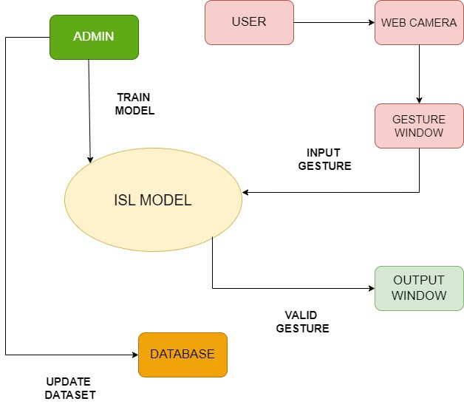
Architecture Diagram( Work-flow)

Slide 8
Architecture Diagram( Work-flow)
The figure represents a system for recognizing and interpreting Indian Sign Language (ISL) gestures. The process begins with the user performing gestures, which are captured by a web camera and displayed in a gesture window for visual feedback. These gestures are then processed by the ISL model, a trained machine learning model designed to recognize and interpret ISL gestures. If the gesture is valid, its interpretation is shown in the output window. The system includes a database that stores the dataset of gestures used for training the ISL model. An admin is responsible for updating this dataset and retraining the model to enhance its accuracy. This continuous cycle ensures the system remains effective in recognizing and interpreting gestures accurately.

Slide 9
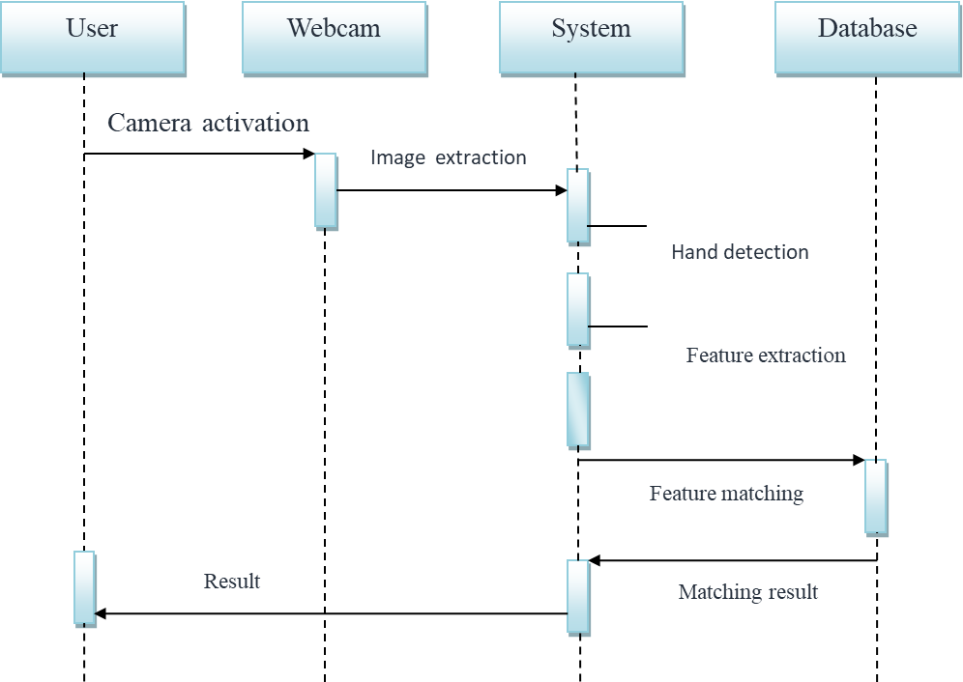
SEQUENCE DIAGRAM

Slide 10
SEQUENCE DIAGRAM
The Diagram represents the workflow of a gesture recognition system, detailing the interaction between the user, webcam, system, and database. The process begins with the user initiating the camera activation. The webcam captures images (image extraction) and sends them to the system. The system first performs hand detection to isolate the hand gestures from the captured images. Following this, it extracts features from the detected hand gestures (feature extraction). These extracted features are then matched against a database of known gesture features (feature matching). The database returns the matching result to the system, which interprets the recognized gesture. Finally, the system sends the result back to the user. This workflow ensures accurate detection, interpretation, and feedback of hand gestures.

Slide 11
METHODOLOGY USED
Data Pre-processing and Feature Extraction:
Hand Detection:
Use MediaPipe to detect hands in webcam images.
Extract the Region of Interest (ROI).
Crop the image and convert it to grayscale using OpenCV.
Apply Gaussian blur.
Convert the grayscale image to binary using threshold and adaptive threshold methods.
Addressing Challenges:
Detect hand landmarks with MediaPipe.
Draw landmarks on a plain white background using OpenCV to avoid issues with background
Collect 180 skeleton images of alphabets A to Z.

Slide 12
METHODOLOGY USED
Gesture Classification:
Convolutional Neural Network (CNN):
Convolutional Layer: Use a small window (e.g., 5x5) to scan the image, creating a 2D activation matrix.
Pooling Layer: Reduce the size of the activation matrix using max pooling (e.g., 2x2 window).
Fully Connected Layer: Connect all inputs to neurons.

Slide 13
METHODOLOGY USED
Model Training:
Train the CNN model with the preprocessed 180 images per alphabet.
Due to poor accuracy with 26 classes, group similar alphabets into 8 classes for initial classification.
Class Refinement:
After initial classification into one of 8 classes, further classify within the group using hand landmark
features to determine the specific alphabet.

Slide 14
Testing Strategy
FUNCTIONAL TEST CASE(UNIT TESTING)
Web Camera Activation: Verify the camera activates and captures frames when the system starts.
Image/Video Capture: Ensure the camera captures clear, lag-free images and videos.
Gesture Detection: Test gesture detection under various lighting conditions.
Pre-processing of Images: Check that images are pre-processed correctly, retaining important details.
Feature Extraction: Confirm accurate extraction of relevant features from gestures.
Feature Matching: Validate high-accuracy matching of extracted features with the stored dataset.
Classification and Comparison: Ensure accurate classification and comparison of gestures to known gestures.
Text Output Display: Verify correct text output corresponding to recognized gestures.

Slide 15
Testing Strategy
PERFORMANCE TEST CASES
System Response Time: Measure the time taken to process a gesture and display the result, aiming for under 2 seconds.
Concurrent User Handling: Test system performance with multiple simultaneous users, ensuring no significant degradation.
BOUNDARY TEST CASES
Edge Case Gestures: Test recognition of gestures that are similar but not identical to those in the training dataset.
Gesture Speed Variations: Verify accuracy with gestures performed at different speeds (slow, normal, fast).

Slide 16
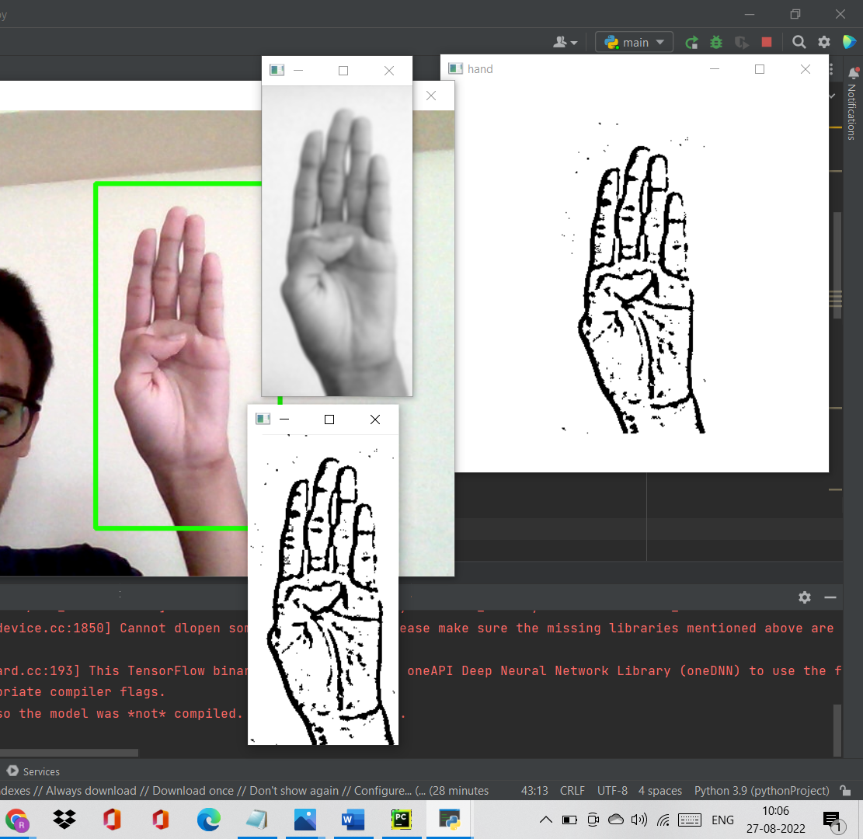
IMPLEMENTATION

Slide 17
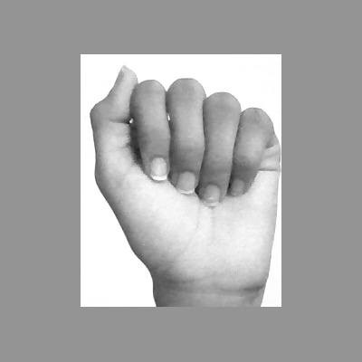
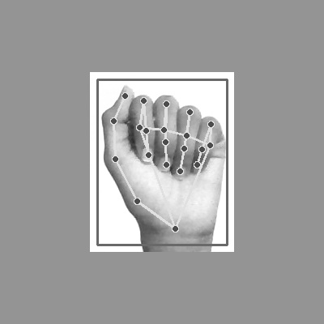

IMPLEMENTATION

Slide 18
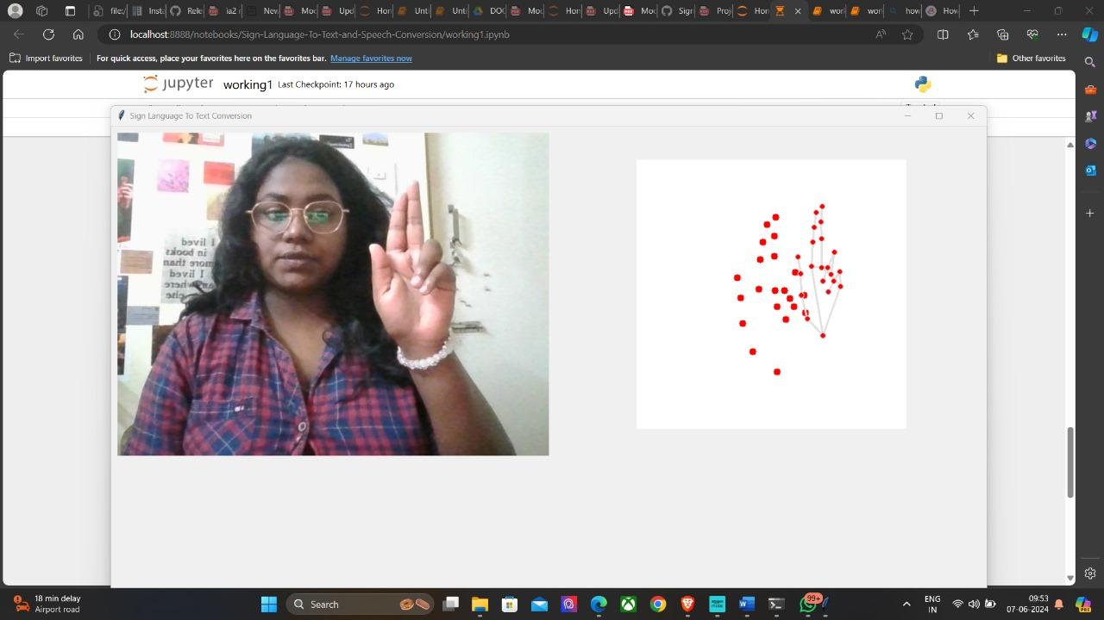
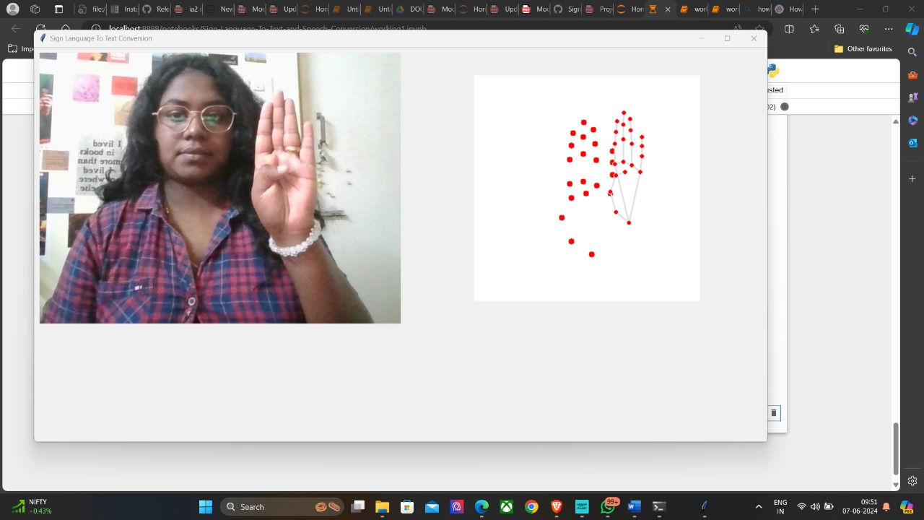
IMPLEMENTATION

Slide 19
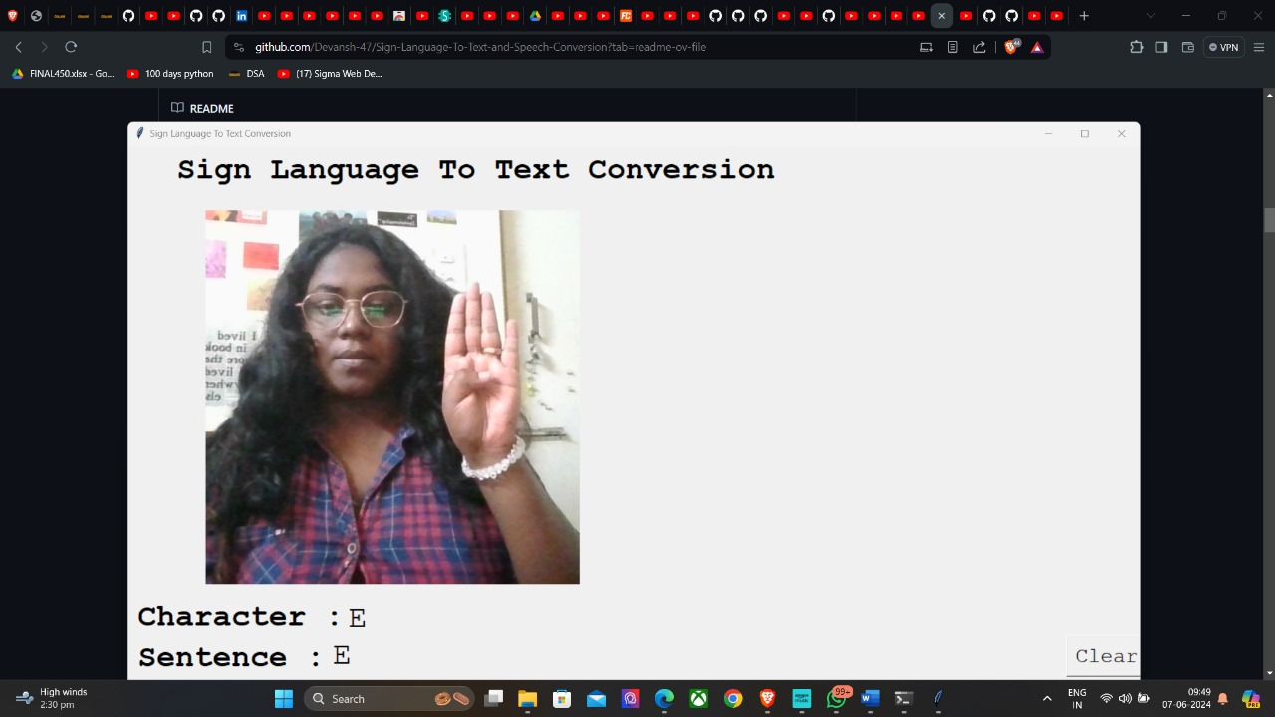
IMPLEMENTATION

Slide 20
RESULT
Robust Real-Time Hand Gesture Recognition:
The system provides real-time detection of hand gestures, ensuring immediate response and interaction.
Cost-Effective and User-Friendly:
Utilizes only a webcam and software libraries, making it affordable and easy to use without specialized equipment.
Handles Background :
Efficiently processes hand landmarks to mitigate issues with varying backgrounds ensuring consistent performance in diverse environments.
Versatile python Application:
Accurately identifies hand gestures for all alphabets from A to Z, making it ideal for applications like sign language interpretation and enhancing human-computer interaction.

Slide 21
Future Enhancement
Expansion of Vocabulary: Integrate a broader range of signs, including regional variations and more complex gestures, to enhance the model's comprehensiveness and versatility.
Multilingual Support: Extend the translation capabilities to support multiple languages, allowing for ISL to be translated into various spoken languages, enhancing accessibility for a global audience.
Contextual Understanding: Incorporate natural language processing techniques to improve the model's ability to understand and translate signs in context, ensuring more accurate and meaningful translations.
Real-time Feedback and Correction: Implement real-time feedback mechanisms that provide users with immediate corrections and suggestions, helping them improve their signing and ensuring more accurate translations.

Slide 22
Thank You

